Slide 1

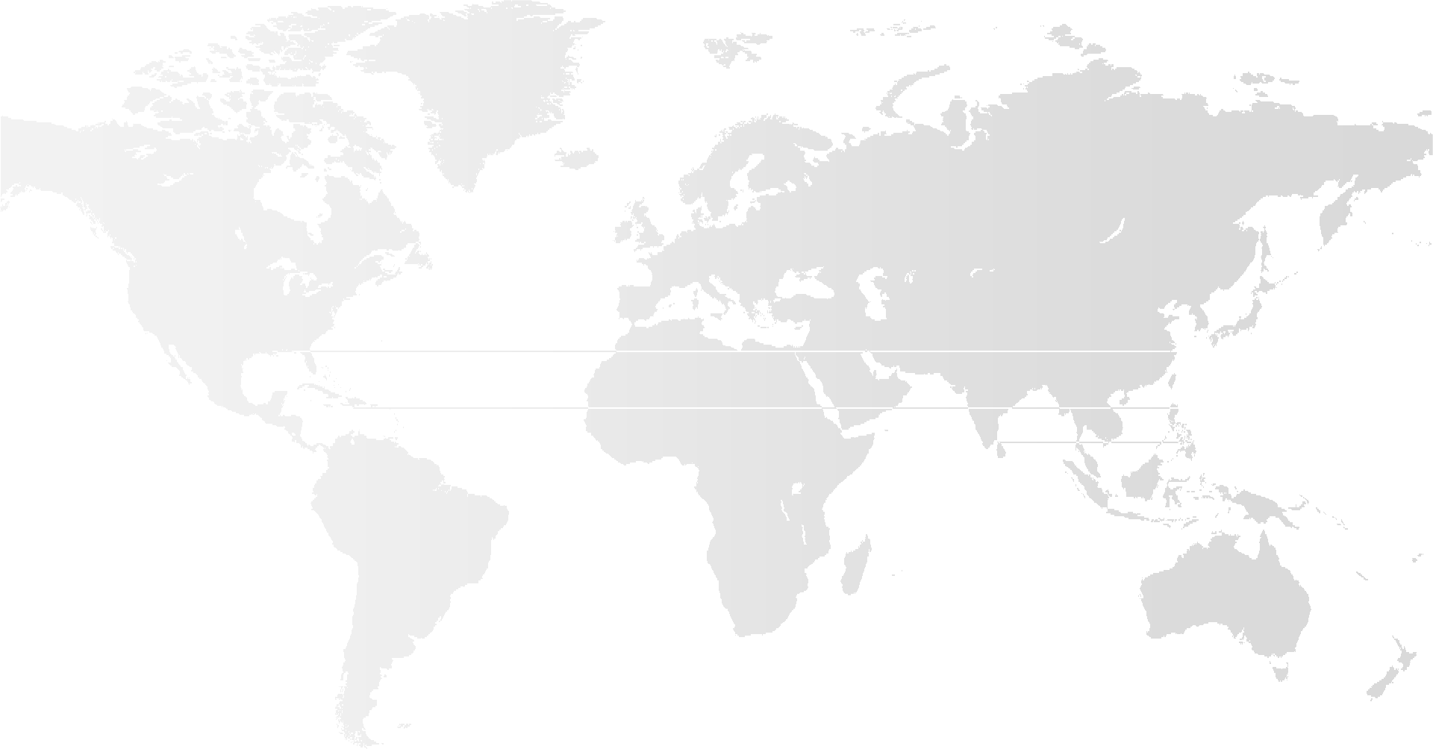
FULBRIGHT HAYS GROUP GRANT “BUILDING BRIDGES THROUGH LANGUAGE AND CULTURE IN RUSSIA”
Dr. Alla Kourova, Associate Professor of Russian/TESOL Dr. Maria Santana, Associate Professor
University of Central Florida

Slide 2

FULBRIGHT HAYS GROUP GRANT “BUILDING BRIDGES THROUGH LANGUAGE AND CULTURE IN RUSSIA”
Dean Jeff Moore Welcome
Message from Director and Co-Director
Introductions of participants
Participants’ folder
  Contract

Slide 3
Director/ Co-Director | UCF Faculty | K-12 Teachers
Dean Jeff Moore | C Barry Morris | Irina Pidberejna
Alla Kourova and M. C. Santana | Anna Lillios | Monica Fishkin
 | Florin Mihai | Samantha Richardson
 | Houman Sadri | Erin Foley
 | Konstrantin Ash | Kerry Sullivan
 | Wendy Howard | Michael Martinez/Scarllett
PARTI
IPANT CAND
IDATES

Slide 4
FULBRIGHT HAYS GROUP GRANT “BUILDING BRIDGES THROUGH LANGUAGE AND CULTURE IN RUSSIA”
What is Fulbright Hays? What Fulbright Scholar?
Kourova, A., & Mikhanova, O.P. (2015). International exchange programs: a brief historical overview. Penza State University Press “University Proceedings in Volga Region” sponsored by Russian Ministry of Higher Education and Science, 4, 146-156.
Ranking and acceptance rate
Goals of Fulbright Hays grant
Eligibility of participants
  Registration in Fulbright (IRIS) website
Press Release and Websites
  Web address needed

Slide 5



TERMS OF THE PROJECT
Pre Departure
In Country
Post Country
Pre Departure
Fall 2017
Spring 2018
In Country
4 weeks
May 25-June25 2018
•Summer 2018
•Fall 2018
Post Country

Slide 6
FULBRIGHT HAYS GROUP GRANT “BUILDING BRIDGES THROUGH LANGUAGE AND CULTURE IN RUSSIA”
Obligations and Responsibilities of Fulbright-Hays Group Project Abroad Participants
Under the grant of the Mutual Educational and Cultural Exchange Act of 1961 (also known as the Fulbright Act), each project participant has certain obligations and responsibilities:
1) Participants are responsible for observing satisfactory academic and professional standards and for maintaining a standard of conduct and integrity which is in keeping with the spirit and intent of the Fulbright program and which will contribute positively to the promotion of mutual understanding between peoples of the United States and those of other countries.
2) Participants should be aware that their public political statements or activity might draw them into the political arena, which can be incompatible with objectives of the project. Participants are responsible for exercising discretion and judgment in all of their actions.
Reasons for possible termination or revocation include:
Acts likely to be offensive to the host country.
Failure to observe satisfactory academic or professional standards
Failure to devote FULL TIME to Project activities.
Engaging in unauthorized income producing activities which are inconsistent with the purpose and best interests of the program.
Minimum of 30 days in the country
The grantee should keep the project length as stated in the approved application.
International travel approval requests should be submitted in IRIS well before travel is to take place, at the very latest, four weeks prior to international departures.

Slide 7
FULBRIGHT HAYS GROUP GRANT “BUILDING BRIDGES THROUGH LANGUAGE AND CULTURE IN RUSSIA”
Obligations and Responsibilities of Fulbright-Hays Group Project Abroad Participants
Travel as a Group:
All group participants and leaders should travel together (unless otherwise authorized by the Program Office) during the international travel and host country phase of the program. At the end of the overseas phase, participants who want to stay longer in the host country or travel elsewhere are required to pay the differences in airfare and must understand that their additional travel is outside the parameters of the Fulbright-Hays Group Projects Abroad Program.
Program Expectations of Participants:
Each participant is the beneficiary of thousands of dollars of U.S. taxpayer funds, so program sponsor expects participants to be prudent and gracious spenders of these funds.
Full and active participation throughout the entire program, in all scheduled events, is expected.
GPA is a professional group program and not designed to cater to specific interests of individuals.
Consider that your behavior can positively or negatively affect the Fulbright program.
As members of the GPA program, keep in mind that you should behave in a way that would make your students, colleagues, children, parents, and country proud!
Many participants state that some of their most valuable interactions were with U.S. colleagues they were traveling with, so learn from and support one another.

Slide 8
FULBRIGHT HAYS GROUP GRANT “BUILDING BRIDGES THROUGH LANGUAGE AND CULTURE IN RUSSIA”
Financial provisions of the project
  Expenses
    Grant
      Stipend
    Participants
Health Information
International Travel
  Passports
  Invitations/Visas
  SCHEDULE SAMPLE for Fall 2017 and Spring 2018/ Summer 2018

Slide 9
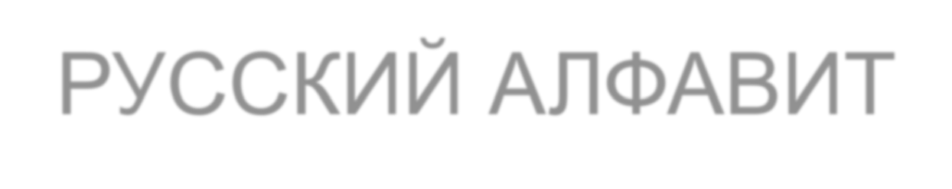

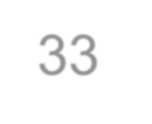
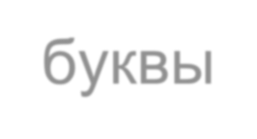
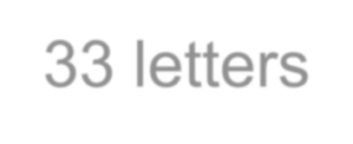
РУССКИЙ АЛФАВИТ RUSSIAN ALPHABET
33 буквы
33 letters
10 гласных
10 vowels
21 согласная
21 consonants
2 знака
2 signs
https://www.youtube.com/watch?v=xQa6tWPCe_g

Slide 10
car
А а а
kind,
class
who
Х х ха
К к ка
but
_{Л л} L uck
эл
meets
Б б бэ
Ц ц це
Ч ч чэ
_{В в} visa _{вэ}
mother
chair
М м эм
_{Г г} g allery
гэ
_{Н н} name
эн
_{Ш ш} shop
ша
doctor
_{О о} old
о
_{Щ щ} sheep
ща
Д д дэ
yet
_{П п} pull
пэ
Ъ ъ твёрдый знак
Ы ы Ь ь
Е е е
Ё ё
yolk
_{Р р} rod
эр
charity
ы
ё
measure
_{С с} sit
эс
Ж ж жэ
мягкий знак
_{З з} visa _{зэ}
_{Т т} talk
тэ
У у у
Э э
excus_{э}e
visa
food
use
И и и
Ю ю ю
philosopher
yard
Й й й (и краткое)
Ф ф эф
Я я я
boy

Slide 11

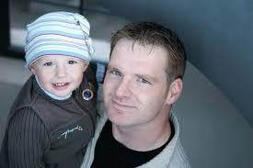
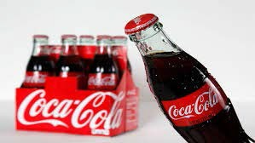
согласные
consonants,which look like Greek letters—remember mathematics and student organizations
Г like g in gram
Ха-ха-ха!
Д like d in delta
Л
Да!
like l in lamp
П like p in pull (looks like Greek π=3,14…. )
Р like r in rod (looks like Greek ρ rho)
Ф like f in fun (looks like Greek ϕ phi)
Х like h in who or ch in Bach (looks like Greek χ chi)
Кока-Кола
ПАПА
папа

Slide 12
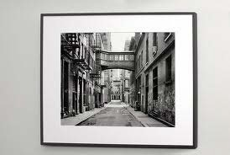
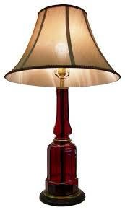
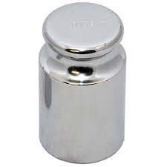
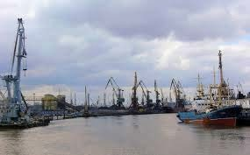

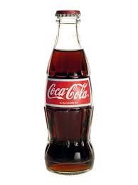
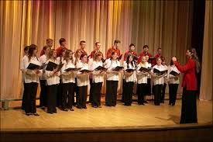
ФОТО
фото
Да.
Ха-ха-ха!
А-ха-ха-ха!!!
ПАПА
папа
ПОРТ
порт
ГРАММ
грамм
ЛАМПА
лампа
ХОР
хор
ПАСПОРТ
паспорт
Кока-Кола

Slide 13
А а Б б В в Г г Д д Е е Ё ё Ж ж З з
И и Й й К к Л л М м Н н О о П п

Slide 14
ЛЁН МАК ВАГОН ЖИЛА БАЛ ВОЛ ОНА

Slide 15
Р р С с Т т У у Ф ф Х х Ц ц Ч ч
Ш ш Щ щ ъ
ы ь
Э э Ю ю Я я

Slide 16
Час
Щи Шуба Сел Съел Язь Эра

Slide 17
MEETING | Formal | Informal
any time | Здравствуйте! | Здравствуй! Привет!
morning | Доброе утро! | Доброе утро!
day | Добрый день! | Добрый день!
evening | Добрый вечер! | Добрый вечер!
Copyright © 2012 by John Wiley & Sons, Inc.

Slide 18
Copyright © 2012 by John Wiley & Sons, Inc.
LEAVING | Formal | Informal
any time | До свидания! Всего хорошего! | Пока!
night | Спокойной ночи! | Спокойной ночи!

Slide 19
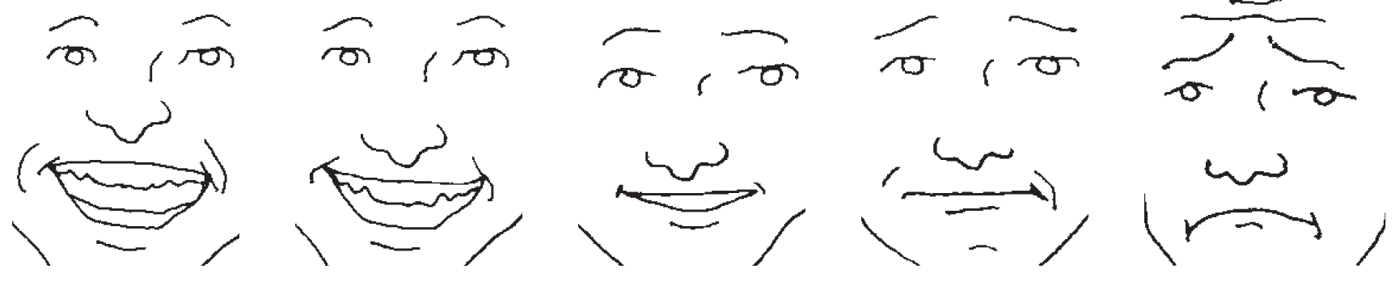
Как дела?
Спасибо, хорошо. А у тебя?
– Тоже хорошо.
отлично
очень хорошо
хорошо
неплохо
плохо
17
Copyright © 2012 by John Wiley & Sons, Inc.

Slide 20
Activity 3. Practice greeting your friends. How many different variations can you make?
Copyright © 2012 by John Wiley & Sons, Inc.
S1: Здравствуй, !
S2: ,
S1: Спасибо,
S2: .
. Как дела?
. А у тебя?
18

Slide 21
Song Moscow nights - https://www.youtube.com/watch?v=Kh5njay3CgU
Book: Picturing Russia: A Research Guide to Russian Culture”
https://he.kendallhunt.com/product/picturing-russia-research-guide
Kourova, A., & Mikhanova, O.P. (2015). International exchange programs: a brief historical overview. Penza State University Press “University Proceedings in Volga Region” sponsored by Russian Ministry of Higher Education and Science, 4, 146-156.
https://cyberleninka.ru/article/v/international-educational- exchange-programs-a-brief-historical-overview
PLEASE ENJOY SIGNING THE SONG, READING THE BOOK AND ARTICLE! SEE YOU ON OCTOBER 27TH!

Slide 22
Thank you! Q/A
Next meeting is October 13, 2017 (4:00- 5:30)
ALLA.KOUROVA@UCF.EDU SANTANA@UCF.EDU

